Slide 1

Unit-03 UI and Design Practices
UI/UX Designing (UI/UX)
DU # 2301CS622
Prof. Mayur Padia
Department of Computer Science & Engineering
mayur.padia@darshan.ac.in
99255 15118

Slide 2

Looping
Outline
Cognitive Studies for Better User Experience
Gestalt Principles
Visual Design
Color Theory
Typography
Using Graphics and Illustrations to Finalize Designs
Informational Components
Containers
Use of Writing in UI Design
Microcopy
User Interface Elements
Input Controls
Output Controls
Helper Elements
Navigational Components
Accessibility in Design

Slide 3
Cognitive Studies for Better User Experience
Section - 1

Slide 4
Cognitive Psychology
Cognitive psychology is a powerful tool for enhancing the field of User Experience design.
It is the study of understanding how the human mind perceives, processes, and interacts with digital interfaces.
Using it designers can create user-centered products that are more intuitive, efficient, and user-friendly.
Cognitive psychology principles are
It results in a superior user experience that provides to the unique needs of individuals.
Attention | Gestalt Principles | Memory
Sensemaking | Decision Making and Choice | Motor processes and interaction
Motivation | Cognitive Biases | Persuasion and Influence
Emotion and delight

Slide 5
Visual Design Principles
Section – 1a

Slide 6
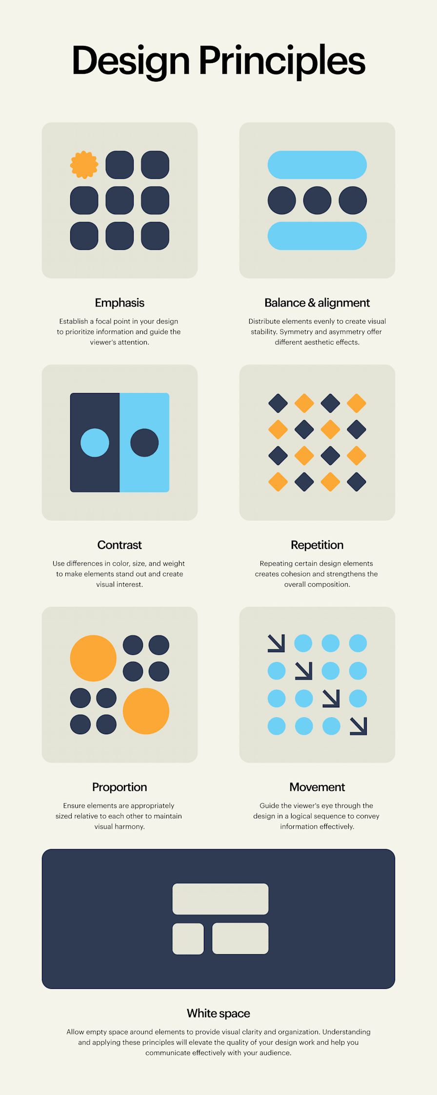

Visual Design Principles
Visual-design principles inform us how design elements such as line, shape, color, grid, or space go together to create well-rounded and thoughtful visuals.
Visual-design principles inform us how design elements go together to create well-rounded and thoughtful visuals.
Good visual design can drive engagement and increase usability.
Video Link

Slide 7
Visual Design Principles
BALANCE
SCALE
VISUAL HIERARCHY
Balance occurs when there is an equally distributed amount of visual signal on both sides of an imaginary axis.
The principle of scale refers to using relative size to signal importance and rank in a composition.
The principle refers to guiding the eye on the page so that it attends to design elements in the order of their importance.

Slide 8
Visual Design Principles (contd.)
CONTRAST
GESTALT PRINCIPLES
The principle refers to the combination of visually dissimilar elements in order to convey the fact that these elements are different.
Gestalt principes capture our tendency to perceive the whole as opposed to the individual elements.

Slide 9
Benefits of Visual Design Principles
It increases usability – following these visual-design principles often results in layouts that are easy to use.
Produce emotion and delight – by following the principles of good visual designs, designers can create UIs that look good and thus make user feel good.
Strengthen brand perception – a strong visual system builds user trust and interest in the product.

Slide 10
Balance

Slide 11
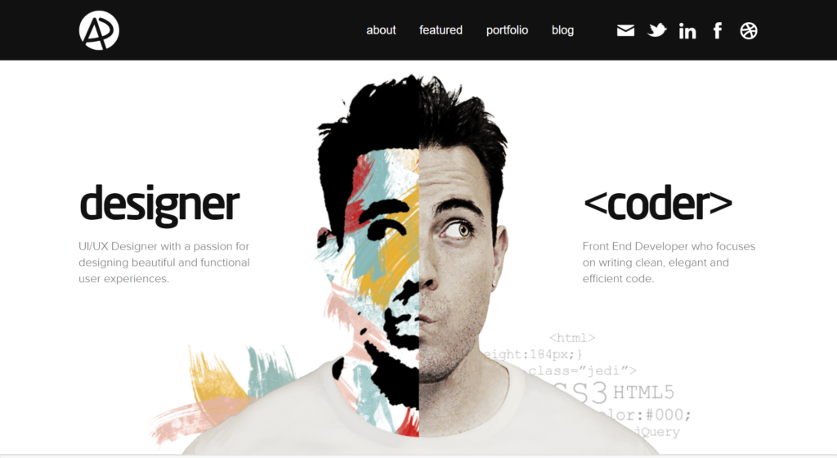
Balance - Visual Design Principle
Balance can be
Symmetrical: elements are symmetrically distributed relative to the central imaginary axis.

Slide 12
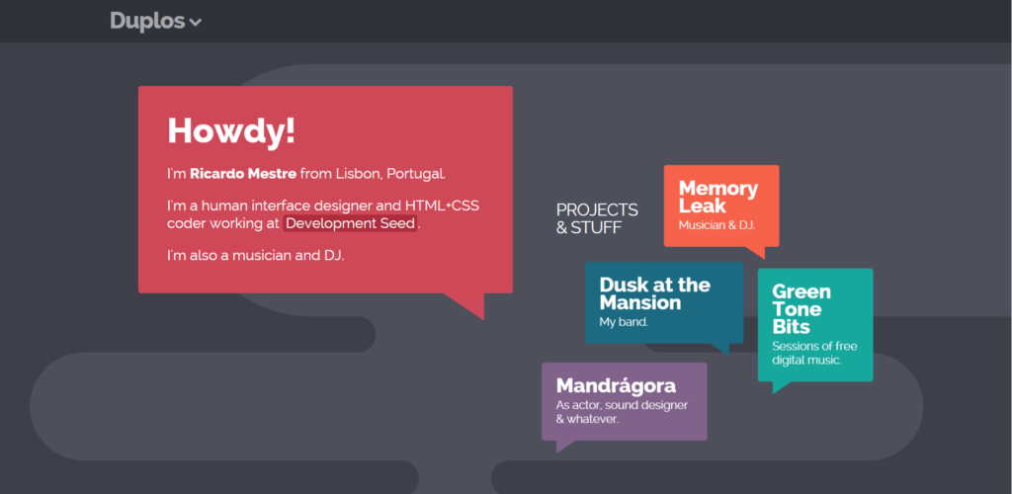
Balance - Visual Design Principle (contd.)
Balance can be
Asymmetrical: elements are asymmetrically distributed relative to the central axis.

Slide 13
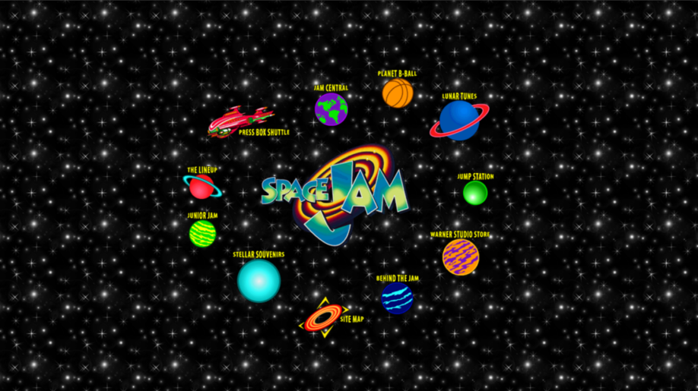
Balance - Visual Design Principle (contd.)
Balance can be
Radial: elements radiate out from a central, common point in a circular direction.

Slide 14
Scale

Slide 15
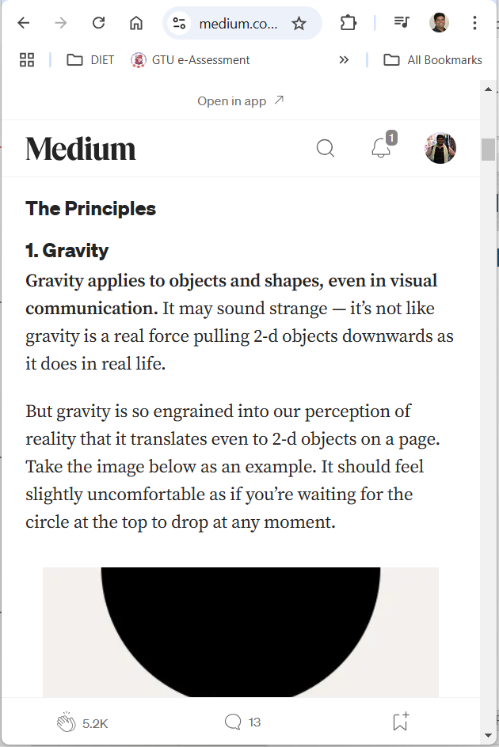
Scale - Visual Design Principle
The principle of scale refers to using relative size to signal importance and rank in a composition.
i.e., the most important elements in a design are bigger than the ones that are less important.
A visually pleasing design generally uses no more than 3 different sizes.
When the principle of scale is used properly and the right elements are emphasized, users will easily parse the visual and know how to use it.

Slide 16
Visual Hierarchy

Slide 17
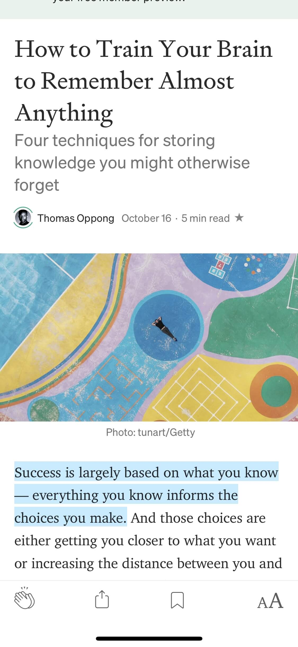
Visual Hierarchy - Visual Design Principle
The principle of visual hierarchy refers to guiding the eye on the page so that it attends to different design elements in the order of their importance.
It can be implemented through variations in scale, value, color, spacing, placement, and a variety of other signals.
To create a clear visual hierarchy, use 2–3 typeface sizes to indicate to users what pieces of content are most important or at the highest level in the page.
Use bright colors for important items and muted colors for less important ones.

Slide 18
Contrast

Slide 19
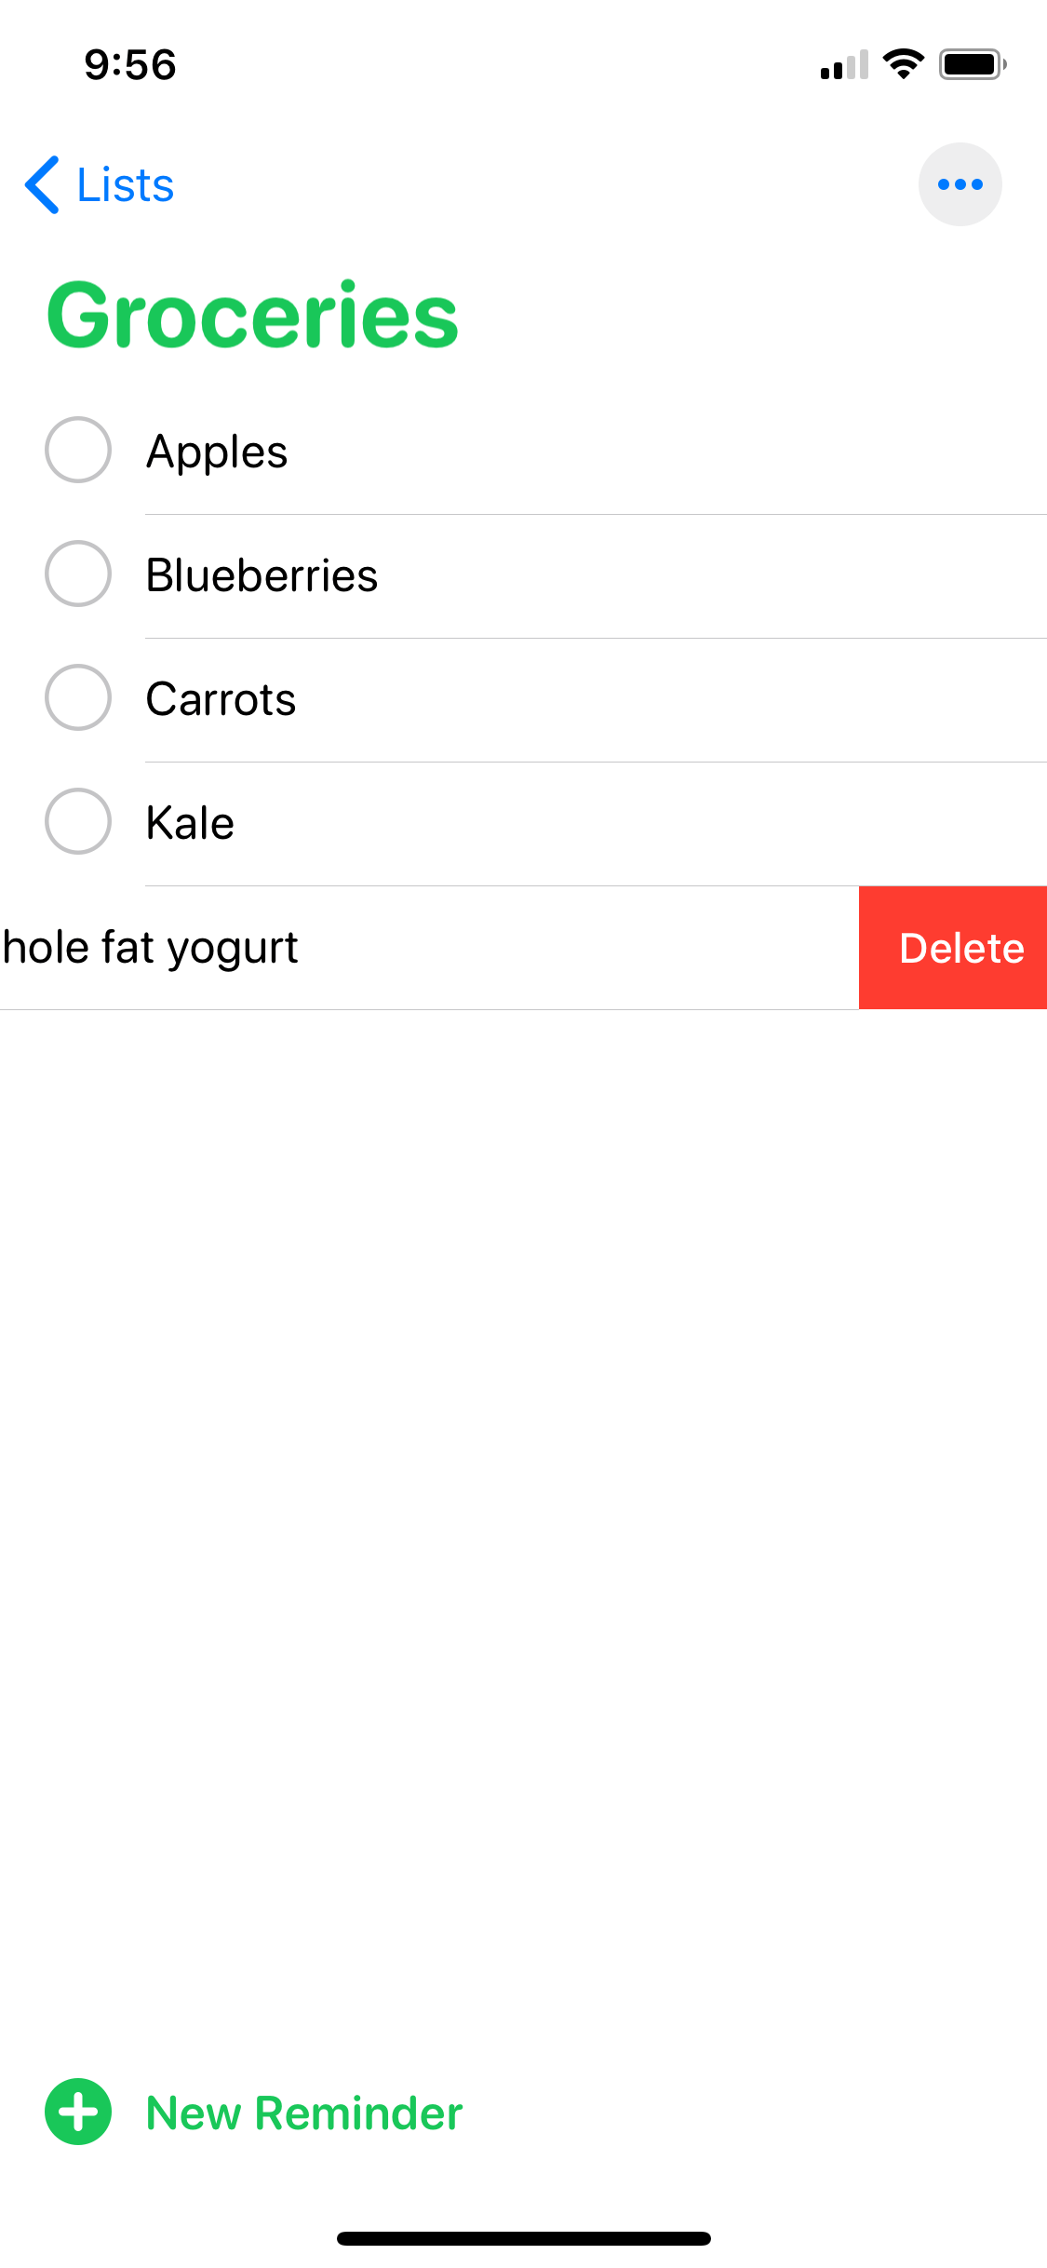
Contrast - Visual Design Principle
The principle of contrast refers to the position of visually dissimilar elements in order to convey the fact that these elements are different.
E.g., component belonging to different categories, have different functions, and behave differently.
Contrast provides the eye with a noticeable difference (e.g., in size or color) between two objects (or between two sets of objects) in order to emphasize that they are distinct.
It can be applied through color.
For example, red is frequently used in UI designs, especially on iOS, to signify deleting.

Slide 20
Gestalt Principle

Slide 21

Gestalt Principle - Visual Design Principle
Gestalt principles capture our tendency to notice the whole as opposed to the individual elements.
Gestalt principles
Similarity
Continuation
Closure
Proximity
Common region
Figure/ground
Symmetry and Order
Common Fate

Slide 22
Gestalt Principle
Section - 2

Slide 23
Similarity Principle of Gestalt
Design elements that appear similar in some way — sharing the same color, shape, or size — are observed as related, while elements that appear dissimilar are perceived as belonging to separate groups.

Slide 24

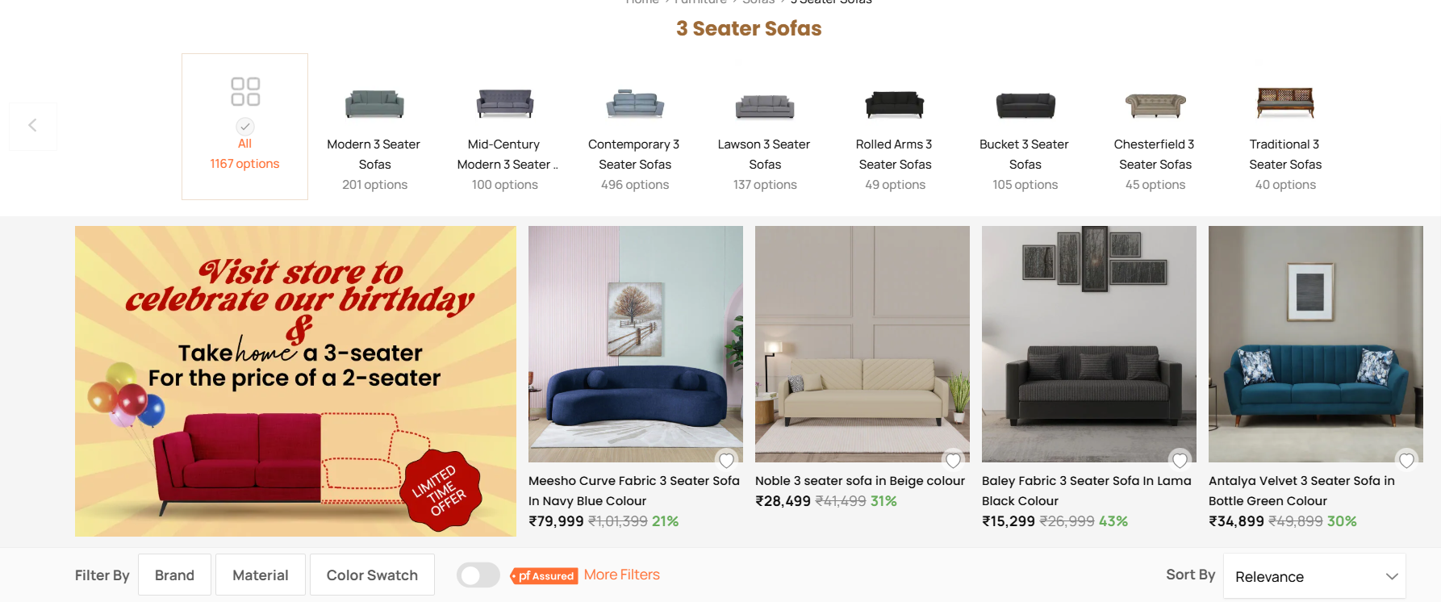
Similarity Principle of Gestalt (contd.)

Slide 25
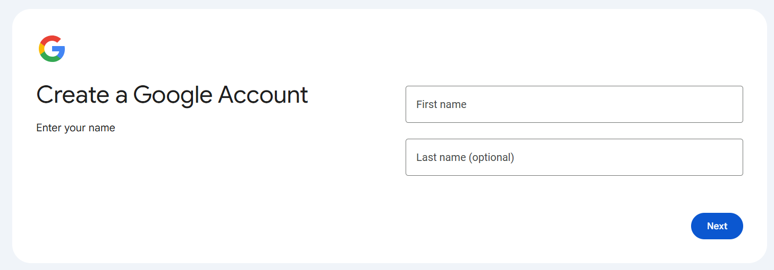
Continuation Principle of Gestalt
The eye automatically follows lines and curves, continuing them.
Employ continuation to guide users along desired paths in the UI.

Slide 26

Continuation Principle of Gestalt (contd.)

Slide 27
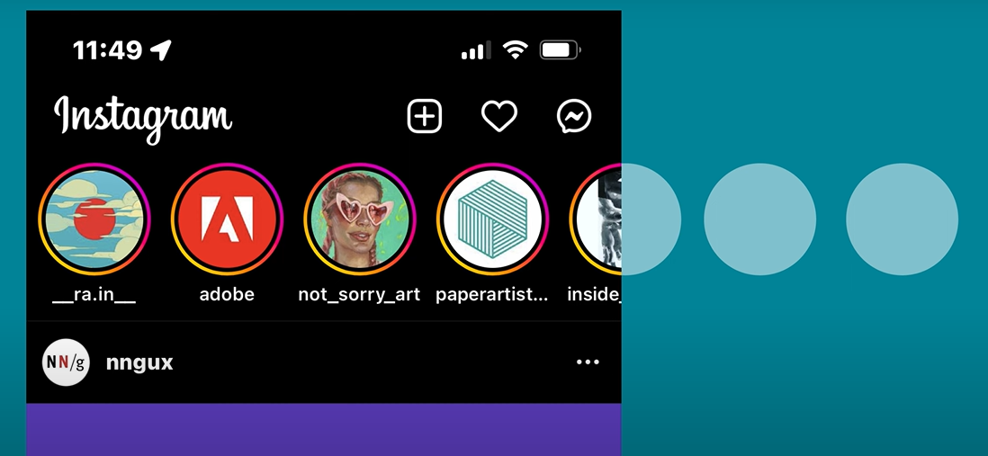
Continuation Principle of Gestalt (contd.)

Slide 28


Closure Principle of Gestalt
The principle of closure states that people will fill in blanks to perceive a complete object whenever an external stimulus partially matches that object.
Even when we’re missing information, we tend to make sense of our environment by filling in the gaps to see a complete object.
This principle is frequently associated with logo design, but it can influence other visual-design decisions related to icons and various page elements.

Slide 29

Proximity Principle of Gestalt
Design elements near each other are perceived as related, while elements spaced apart are perceived as belonging to separate groups.
The practice of placing related elements close together and separating unrelated elements can be seen almost everywhere in UI design.
Using varying amounts of whitespace to either unite or separate elements is key to communicating meaningful groupings.

Slide 30
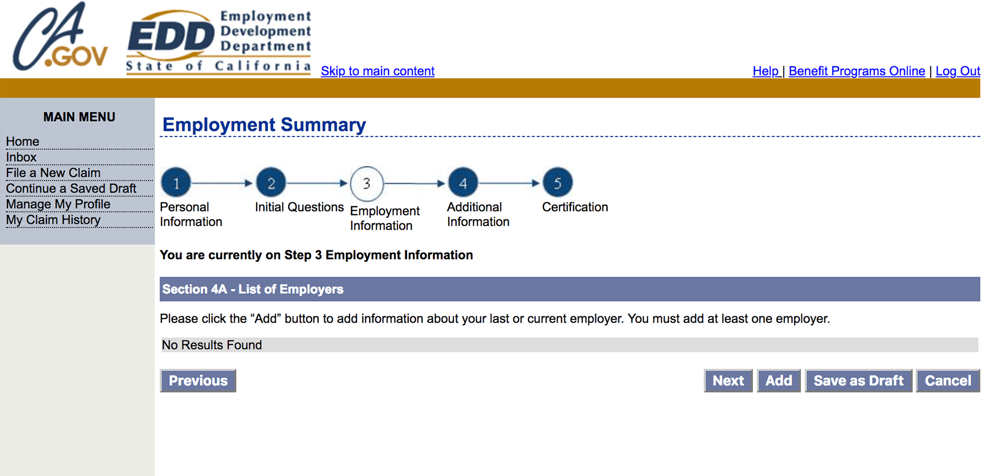
Proximity Principle of Gestalt (contd.)
Grouping together unrelated elements may camouflage them from users.
When looking around the page, users may only look at one item within a perceived grouping and use that to make a judgement about what the other items in that group must be.

Slide 31
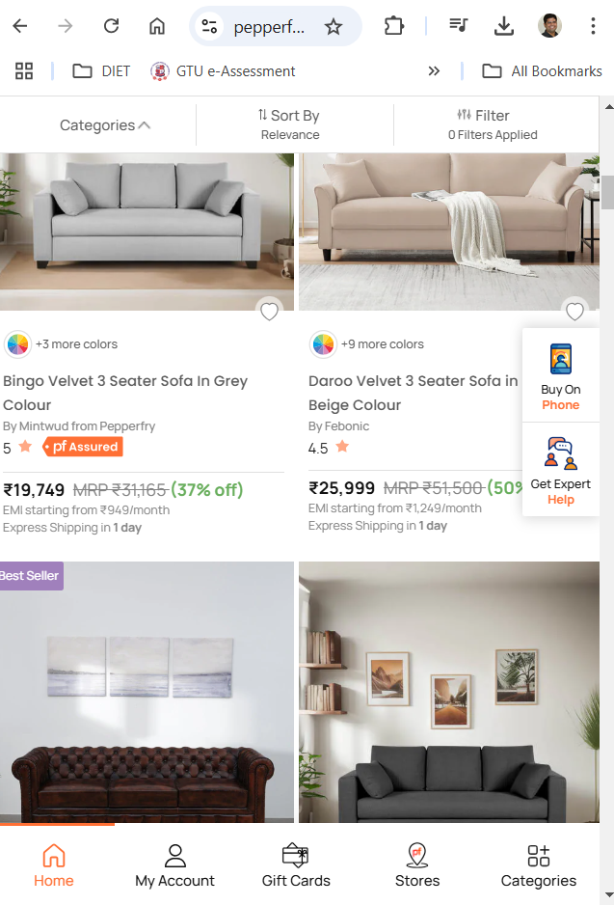

Proximity Principle of Gestalt (contd.)
Far-away elements appear unrelated, are easily overlooked
Paying attention to the proximity of elements is particularly important when designing responsive layouts, as these groupings may change as varying screen adapt to sizes.

Slide 32
Common Region of Gestalt
The principle of common region says that items within a boundary are perceived as a group and assumed to share some common characteristic or functionality.

Slide 33

Common Region of Gestalt (contd.)
Create containers using:
Border
Background Color
Pattern

Slide 34
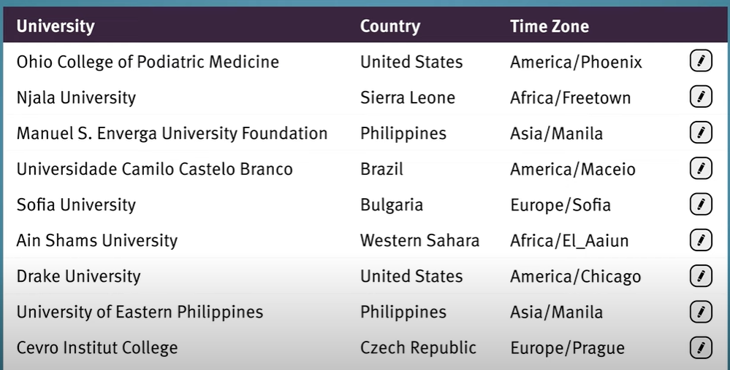
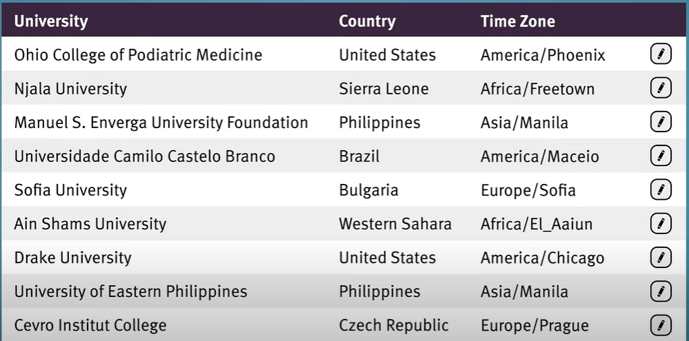
Common Region of Gestalt (contd.)

Slide 35
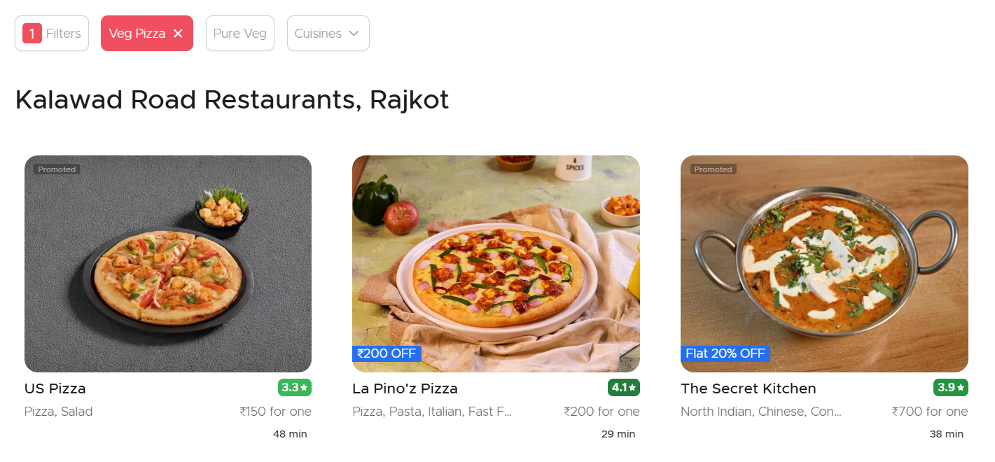
Common Region of Gestalt (contd.)
Designating the header, footer, left navigation panel, or other areas of a UI using a background color is often used to create common regions that visually separate from content.
Websites with fixed or “sticky” headers can especially benefit from using a distinguishing background color or clear border, to effectively separate the header from the page content scrolling below.

Slide 36
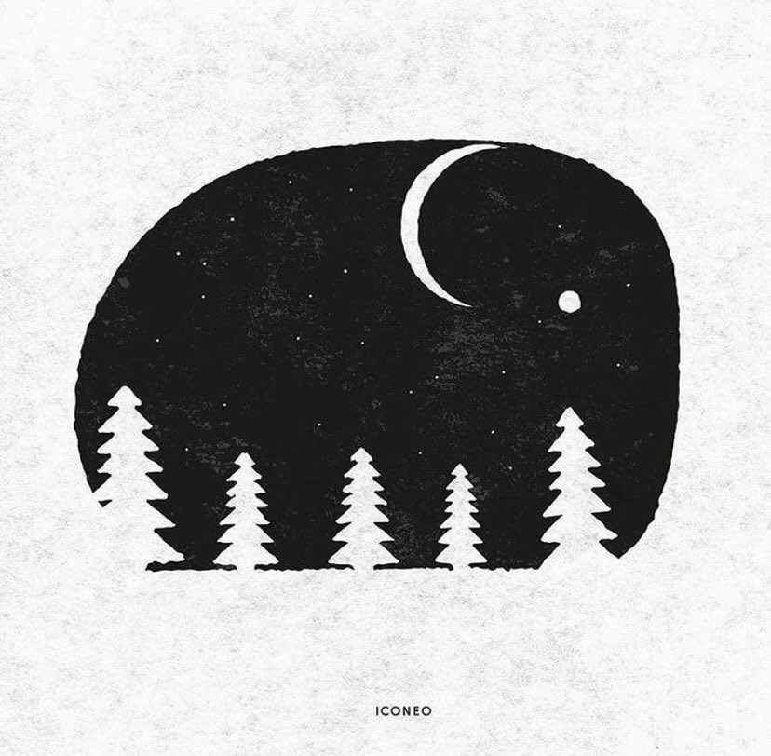
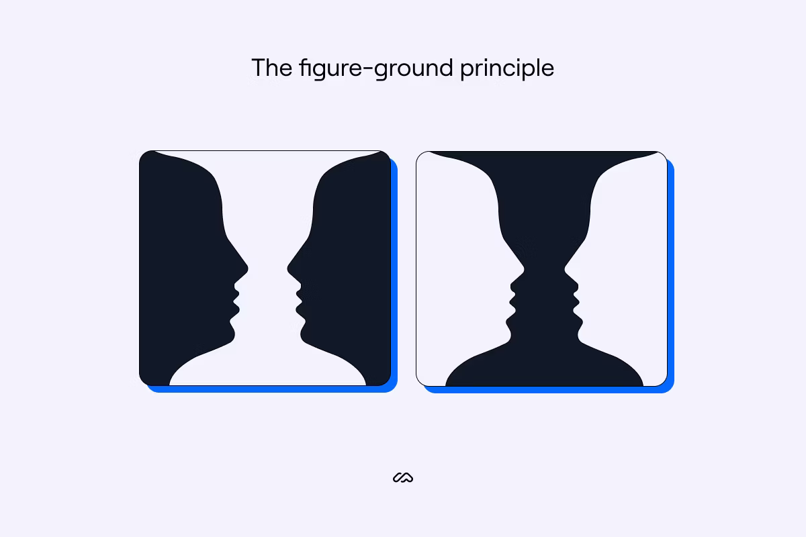
Figure/ground of Gestalt
It describes how humans perceive an image as they separate it into the figure—foreground—and ground—background.
Designers use it to create a clear visual hierarchy between the front “figure” and surrounding “ground,” and so guide users’ attention to important design elements.
It offer users the guidance in performing tasks and get to and through the goals they want to on a website or app.

Slide 37
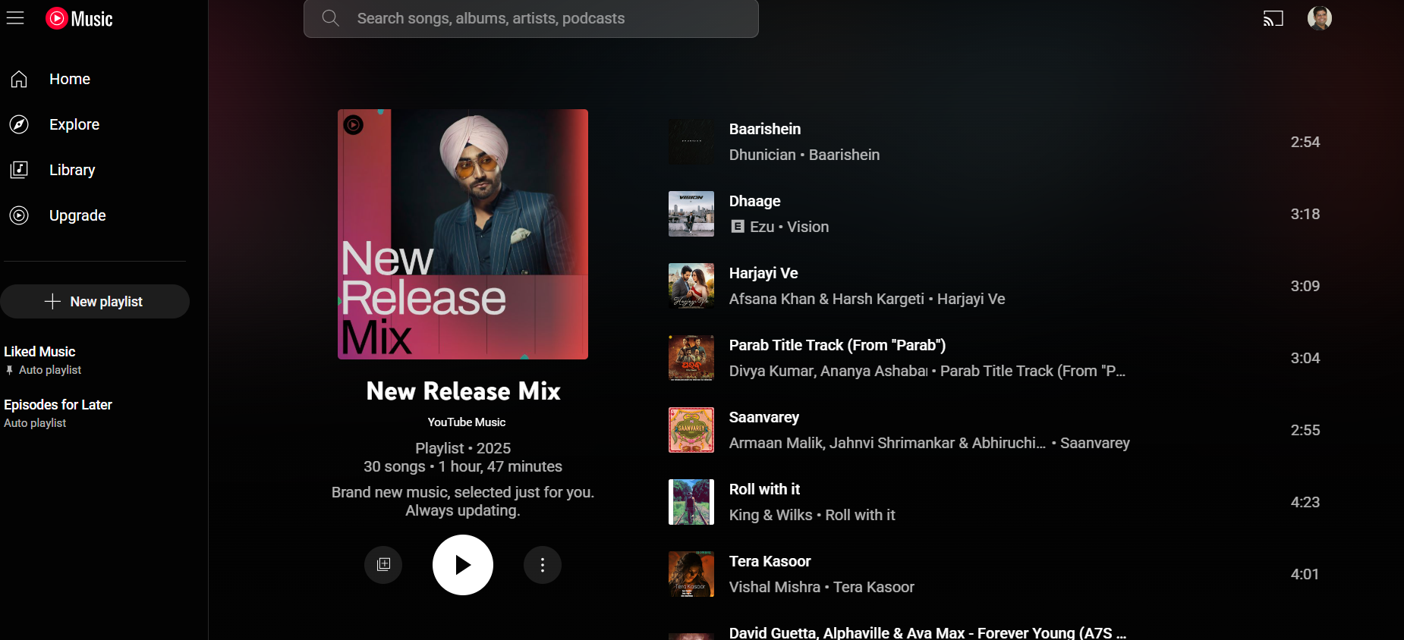

Figure/ground of Gestalt (contd.)
The Figure/Ground principle is all about using visual cues to indicate what is important (foreground/figure) and what is not important (background/ground).
Three common techniques to do this are:
using contrast (color, size, level of detail)
using boxes to separate content (overlap)
using shadows to provide depth

Slide 38
Symmetry and Order Principle of Gestalt
Humans tend to see visual elements as grouped when they are arranged symmetrically.
The natural world is filled with symmetry (or near symmetry), and our brains tend to favor symmetrical forms.
Grid systems that evenly divide the space help designers implement symmetry and order in user interfaces.
[
}
{
}

Slide 39
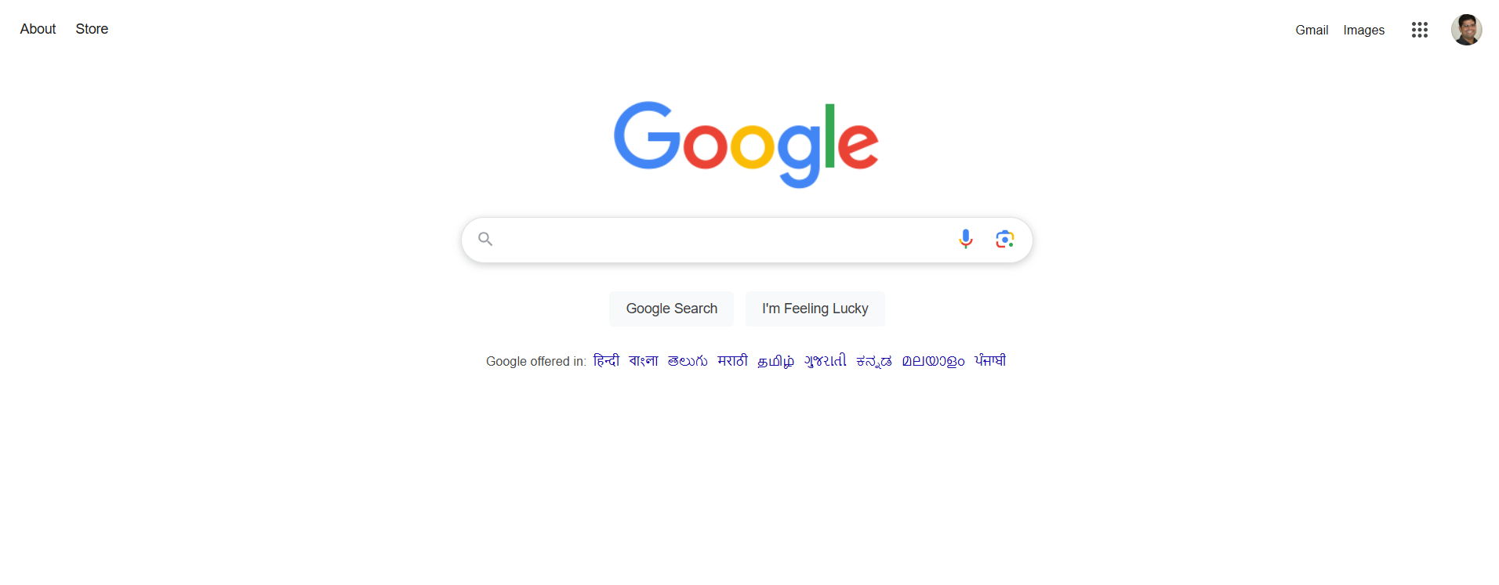
Symmetry and Order of Gestalt (contd.)

Slide 40


Common Fate Principle of Gestalt
When you watch a flock of birds flying harmoniously across the sky, what do you notice?
You perceive them as a single entity, moving in a coordinated, collective manner.
Law of Common Fate suggests that when objects move in the same direction or at a similar pace, our brains automatically group them together.
We perceive these objects as a cohesive unit, sharing a ‘common fate’.

Slide 41



Common Fate (contd.)
When you select multiple files in Google Drive, an overlay appears on the selected files, indicating they’re grouped.
If you drag one, the rest follow, illustrating the Law of Common Fate.
When browsing Netflix, movies and TV shows are grouped into rows based on genre or theme.
As you scroll horizontally, each row moves together, reinforcing the perception that the titles within a row are related.
LinkedIn have used the law of common fate to build a relationship between sub-menus.
When you move over a menu item, the sub-menu item moves in the same direction as the last. This creates a link between sub-menus in the minds of the users.

Slide 42
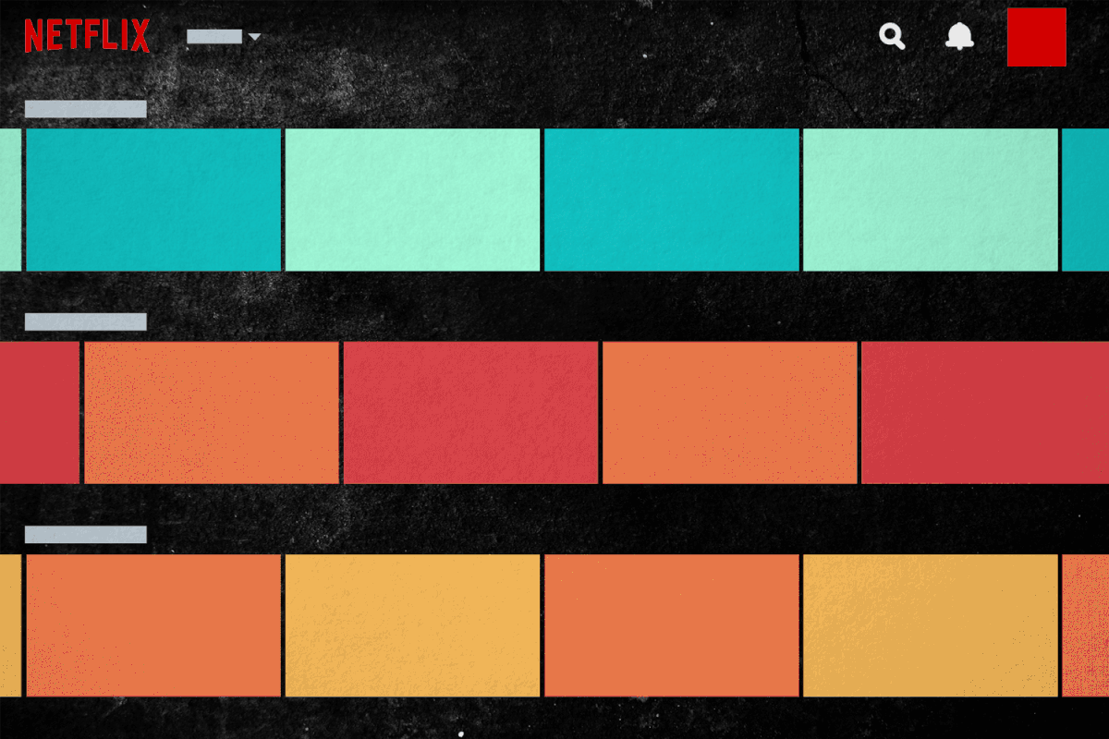
Common Fate (contd.)

Slide 43
Visual Design
Section - 3

Slide 44
Visual Design
Visual design uses typography, color, and layout to create an engaging and intuitive user experience.
Color theory and typography are two essential elements of visual design that can affect the mood, readability, and message of content.
By understanding key principles such as contrast, alignment, repetition, and proximity, designers can create visually appealing and coherent works that capture the audience's attention and convey information efficiently.
Elements of visual design are:
Color: Sets the mood and creates emotional connections.
Typography: Choice of font impacts readability and conveys the message's tone.
Imagery: Use of illustrations, photos, and icons to enhance visual interest.
Space: Effective use of space helps in content organization and readability.
Lines and Shapes: Used to create structure and guide the viewer’s eye through the layout.

Slide 45
Color Theory
Color theory is the study of how colors work together and how they affect our emotions and perceptions.
It's like a toolbox for artists, designers, and creators to help them choose the right colors for their projects.
Color theory enables you to pick colors that go well together and convey the right mood or message in your work.
By systematically categorizing colors, there are three groups:
Primary (red, blue, yellow).
Secondary (mixes of primary colors).
Tertiary (or intermediate—mixes of primary and secondary colors).
In screen design, designers use the additive color model, where red, green and blue are the primary colors.
Consider using any of these main color schemes:

Slide 46
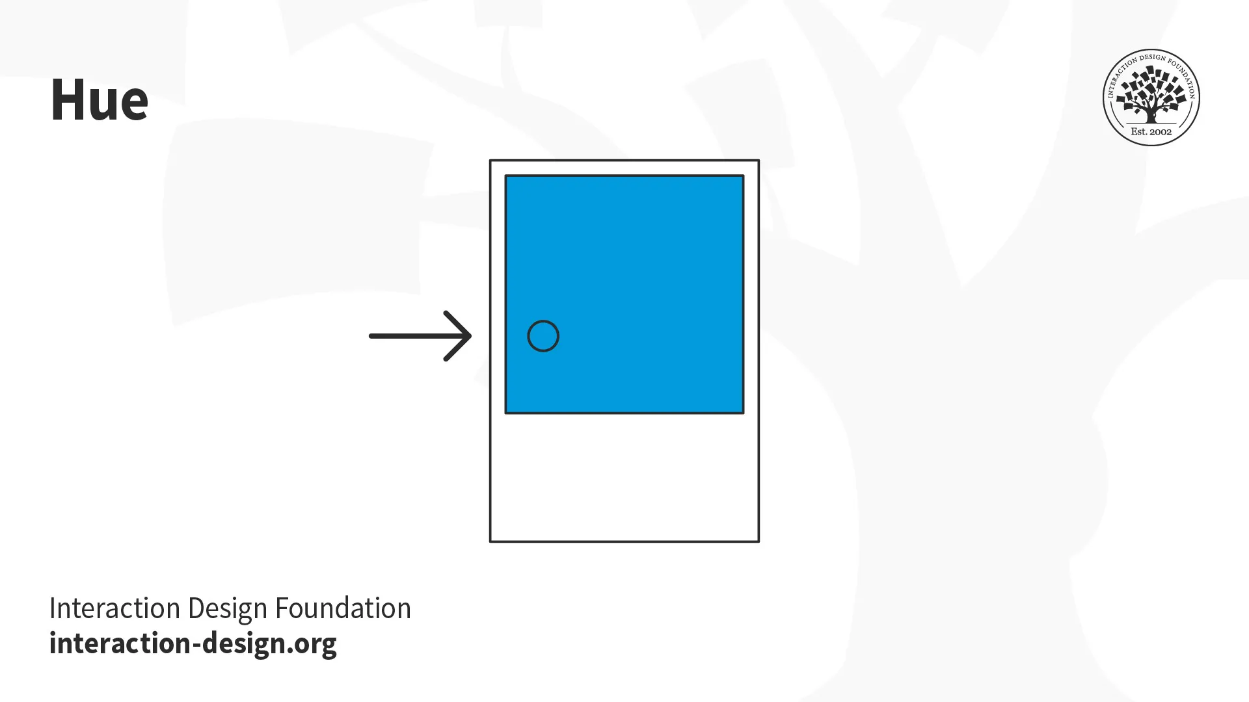
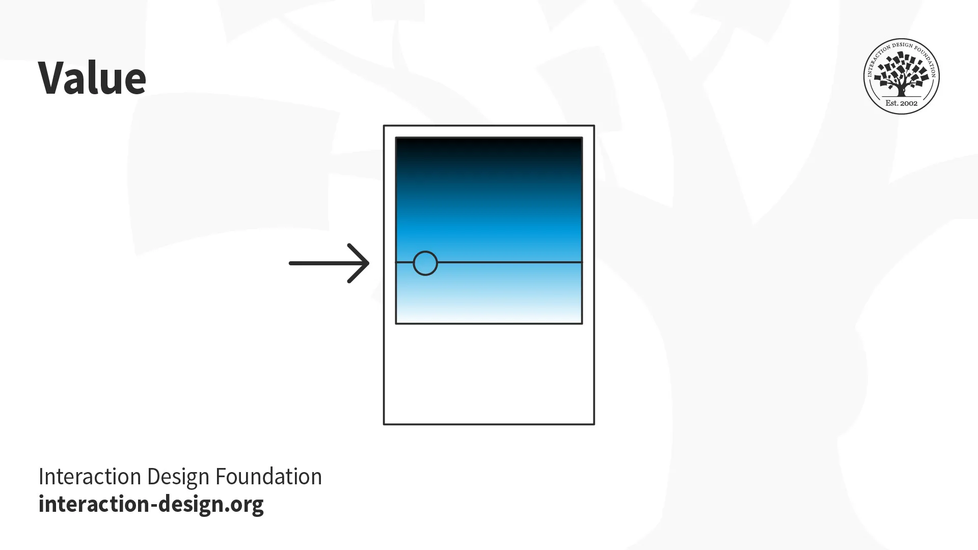
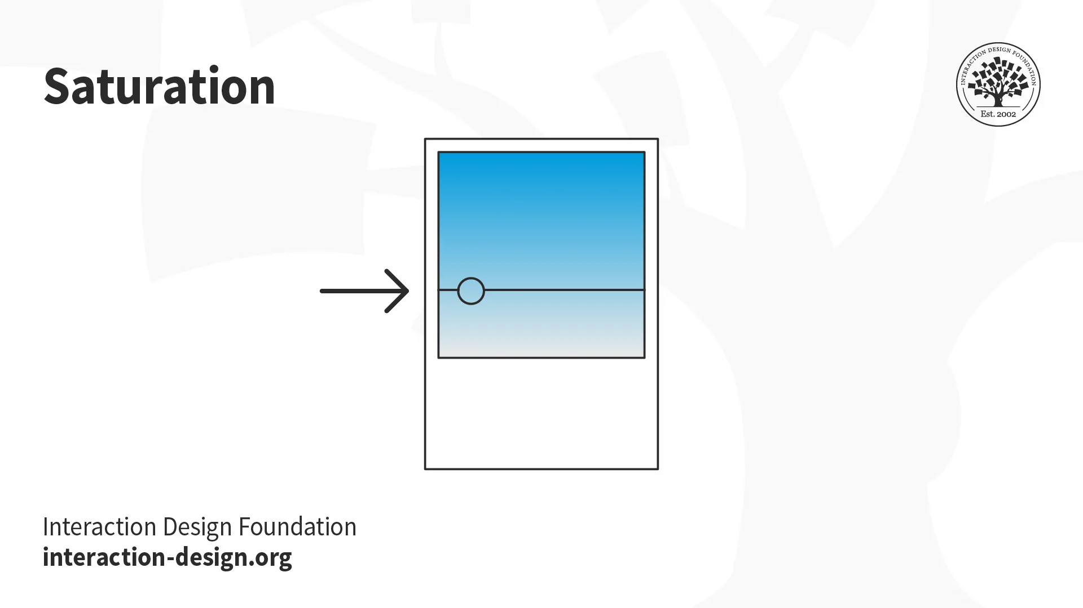
What Are Hue, Value and Saturation?
Hue is the attribute of color that distinguishes it as red, blue, green or any other specific color on the color wheel.
Value represents a color's relative lightness or darkness or grayscale and it’s crucial for creating contrast and depth in visual art.
Saturation, also known as intensity, refers to the purity and vividness of a color, ranging from fully saturated (vibrant) to desaturated (grayed).
LINK
HUE
VALUE
SATURATION

Slide 47
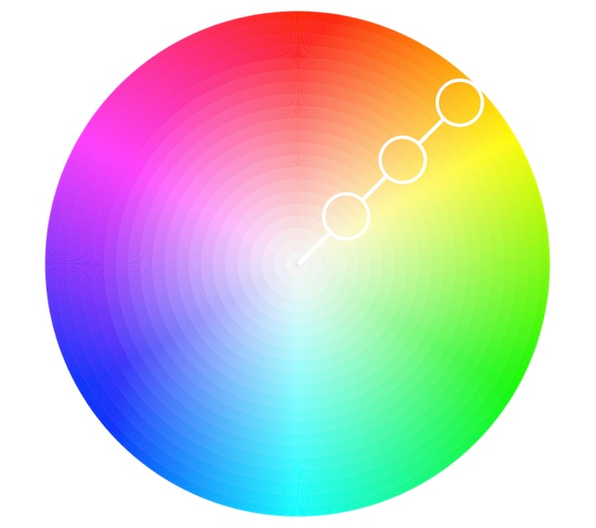
Types of Color Palette
Monochromatic color schemes are formed using various tones and shades of one single color.

Slide 48
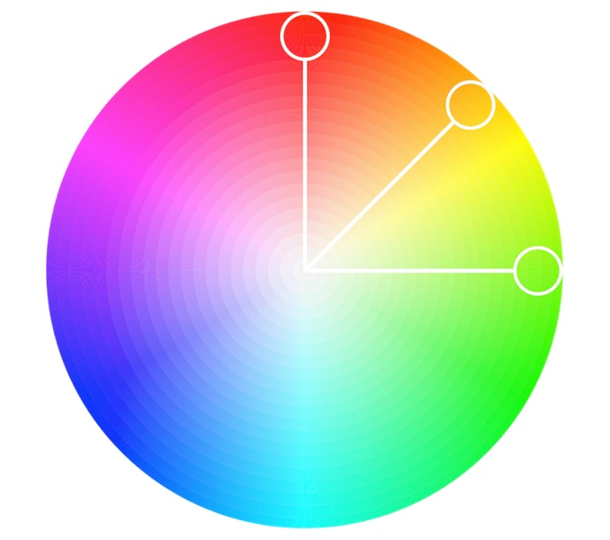
Types of Color Palette (contd.)
Analogous color scheme is formed of three colors that are located next to each other on the color wheel.

Slide 49
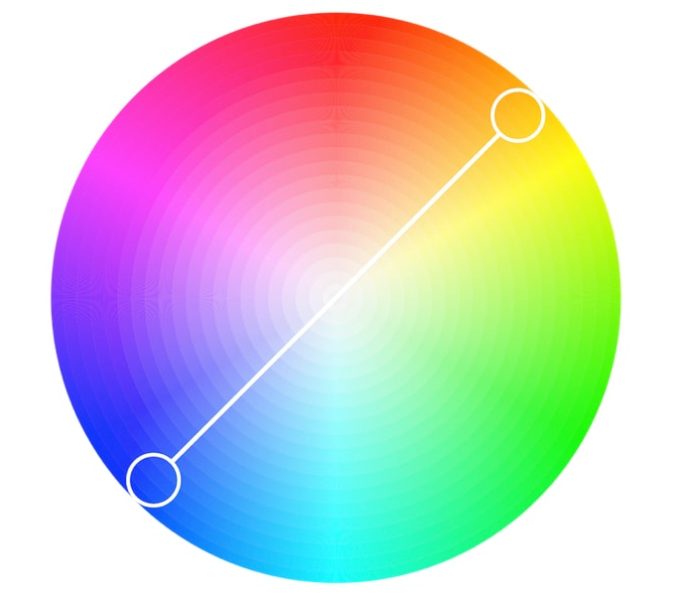
Types of Color Palette (contd.)
Complementary color palettes are comprised of colors that are placed in front of each other on the color wheel.

Slide 50
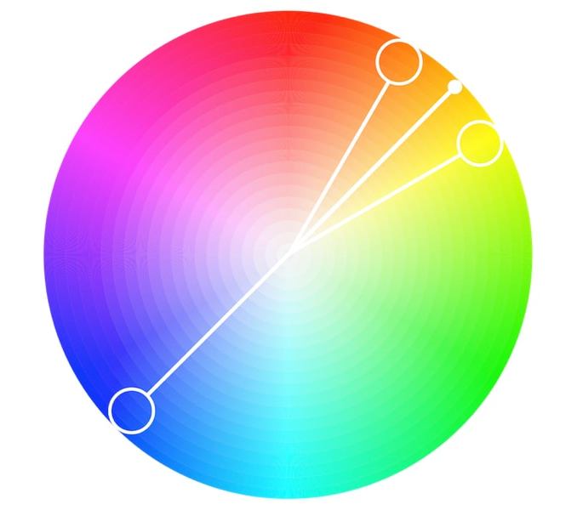
Types of Color Palette (contd.)
Split-complementary color palette differs from the complementary color palette only in that it employs a higher number of colors. E.g., if you choose the color blue, you’ll then need to take the two colors that are adjacent to its opposite color, which in this case would be yellow and red.

Slide 51
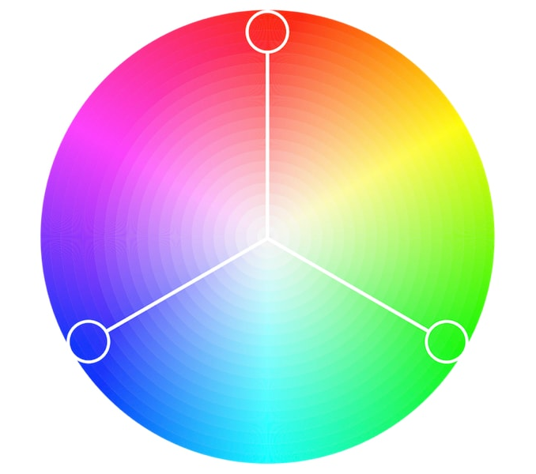
Types of Color Palette (contd.)
Triadic color scheme is based on three separate colors that are equidistant on the color wheel.

Slide 52
Tools for choosing a color palette
Adobe Color
Coolors

Slide 53
Typography

Slide 54
Why Typography?

Slide 55
#Fact
“>90% of the information on the web is written language.”
- Oliver Reichenstein

Slide 56

Typography
Typography focuses on using fonts and typefaces to make text easy to read, clear, and visually appealing.
It involves the style, appearance, and structure of fonts to evoke emotions and communicate messages effectively.
Typography maintains visual balance and improves accessibility by making the text highly readable.

Slide 57
Why Typography is Important?
Reflects personality and looks professional.
Helps to be consistent.
Helps user remember your product.
Sets the right tone and creates context.

Slide 58
Elements of Typography
Element | Description
Fonts and Typefaces | Fonts refer to the weights, widths, and styles that constitute a typeface, and a typeface is a family of related fonts. The three basic kinds of typeface are serif, sans-serif, and decorative.
Consistency | Keeping your typefaces consistent is the key to avoiding confusion.
White space | Also known as ‘negative space,’ white space is the space around text or graphics. It tends to go unnoticed by the user, but proper use of white space ensures the interface is uncluttered.
Alignment | It ensure there is equal space, size, and distances between element.
Color | Color has three key components: value, hue, and saturation.
Hierarchy | Typographical hierarchy aims to create a clear distinction between prominent pieces of copy that should be noticed and read first, and standard text copy.
Contrast | Contrast helps to convey which ideas or message you want to emphasize to your readers.

Slide 59
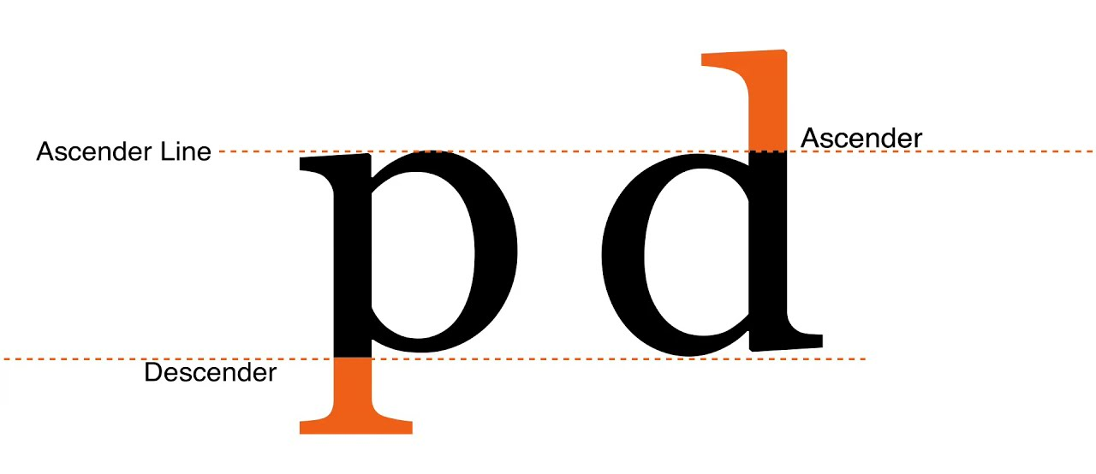
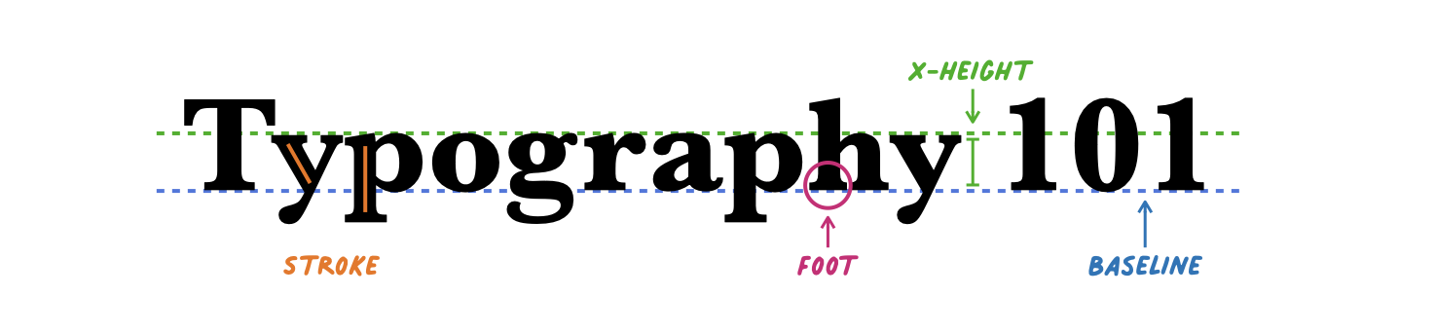
Typographic Classifications
A typeface, also known as a font family, can set the overall tone and personality of your site or application, as well as increase (or decrease) readability.
Some common characteristics of typefaces are:
Baseline: An imaginary line where letters sit
X-height: The height of the typeface’s lowercase letters, not including ascenders or descenders
Foot: the part of the letter that rests on the baseline
Stroke: A single line, straight or curved, that makes up a part of a letter

Slide 60
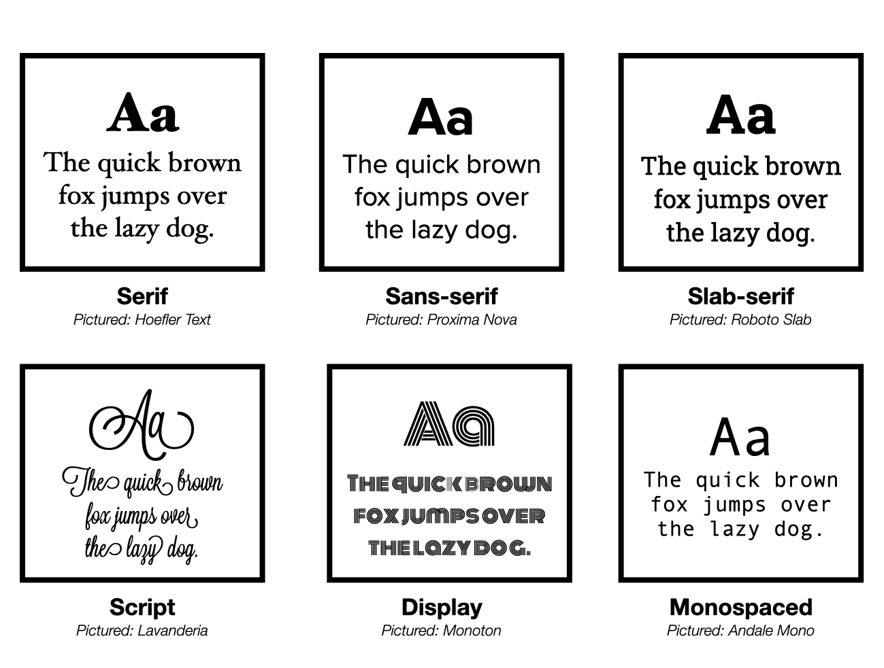
Typographic Classifications (contd.)
Classifications of typefaces categories:
Serif: Typefaces that use feet at the end of character strokes and often use varying letter-stroke widths
Sans-serif (French for “without serif”): Typefaces without feet, which often have thinner letter strokes and larger x-heights
Slab-serif: Typefaces that possess thick, block-like serifs that match the overall letter stroke
Script: Typefaces that are decorated with flourishes meant to resemble handwriting
Display: Typefaces that stand out with decorative features and are meant to be used at large sizes
Monospaced: Typefaces with all or most characters taking up the same horizontal space (whereas in most typefaces, letters like W are much wider than letters like J)

Slide 61
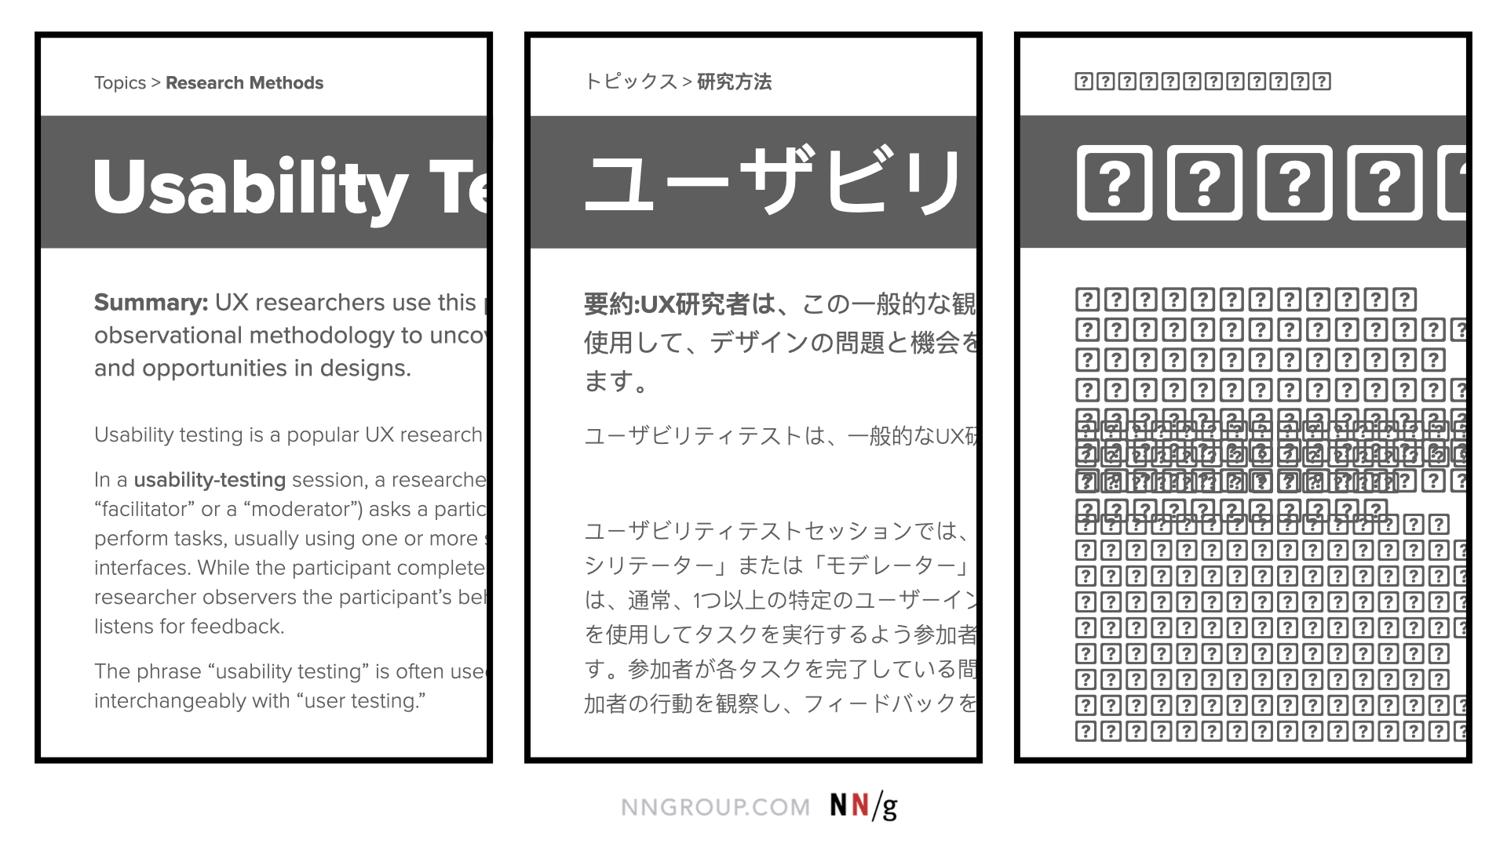
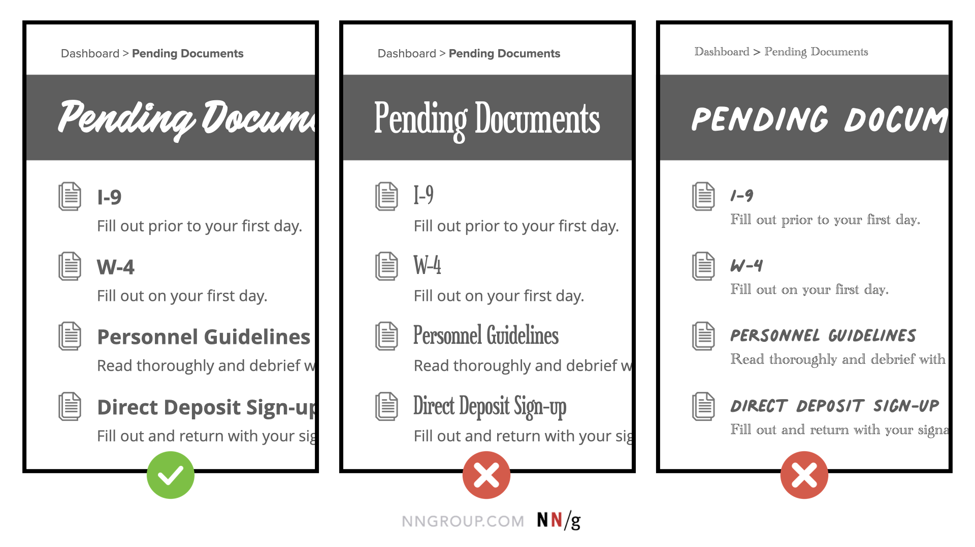
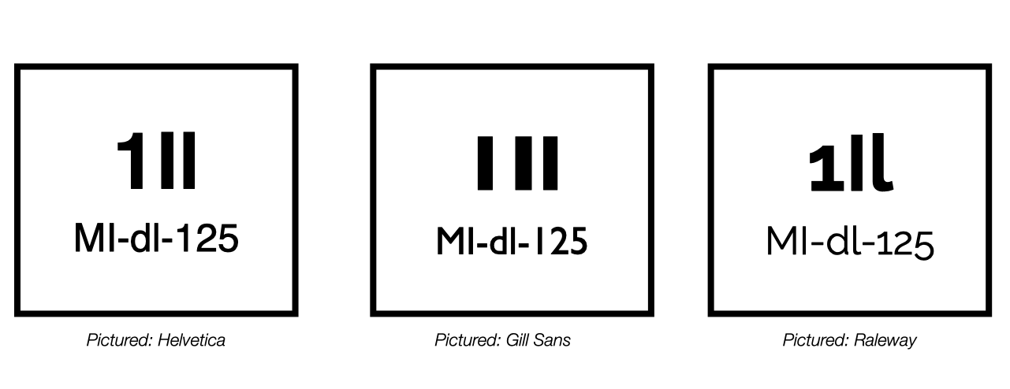
Typographic Classifications (contd.)
Look for typefaces that support multiple languages
Assess the similarities between characters
Some typefaces, especially sans-serifs, have unclear distinctions between characters.
Check how well your candidate typeface differentiates between the number 1, the uppercase i, and the lowercase L.
Mix Decorative Fonts with Neutrals
Script and display typefaces bring brand personality into your site or application and set you apart from competitors.
Less is more.
The i-L-1 Test is a simplified way to determine if a typeface has distinct characters.

Slide 62
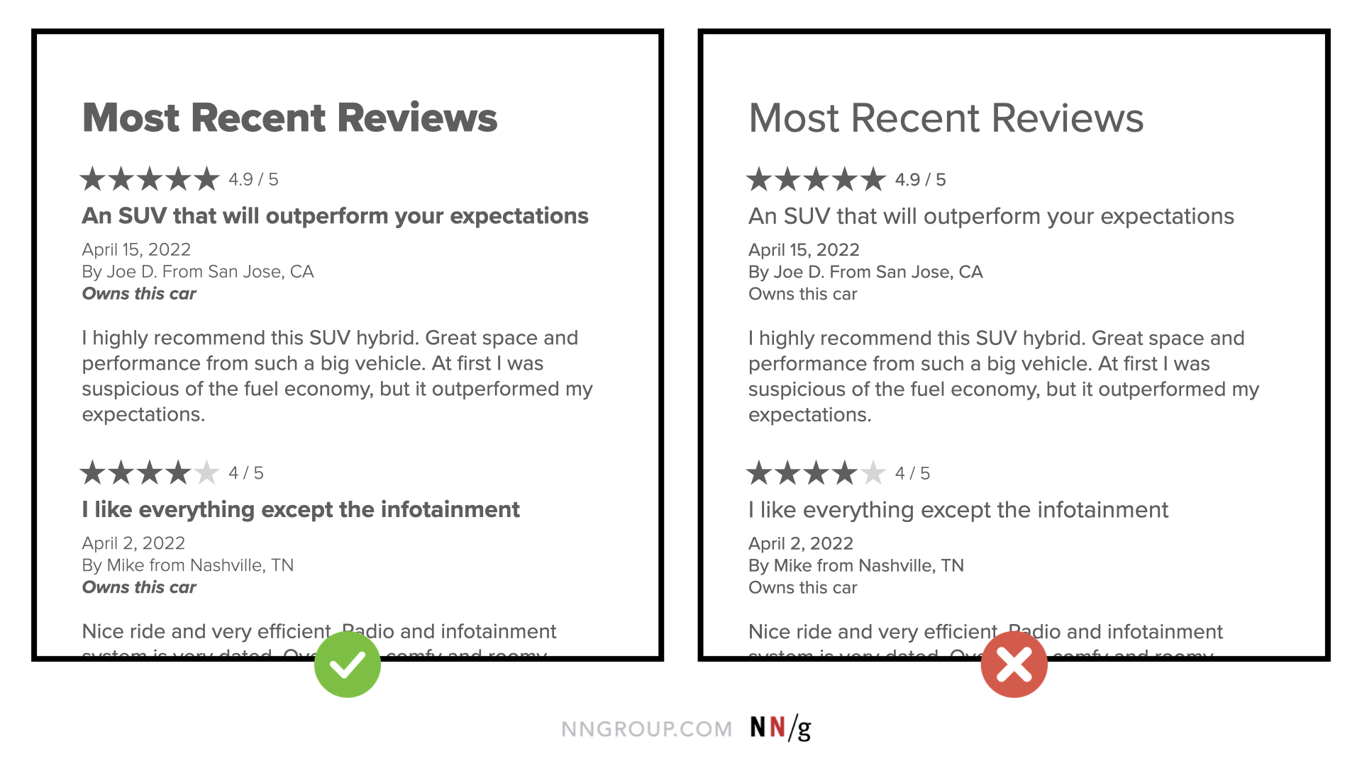
Typographic Classifications (contd.)
Use Contrasting Font Weights to Distinguish Components
A design that uses a single typeface with multiple weights can look professional and well-balanced.
Using multiple font weights, styles, and sizes will help define the page’s visual hierarchy, which will guide the users’ eyes around the screen.
Consider looking for font families that include the following options:
Light
Regular
Bold
Light italic
Italic
Bold italic

Slide 63
Typography Tools
material.io
Typescale
Good Line Height
Figma Plugin
Typescale
Good Line Height
Fonts Changer
Font Fascia

Slide 64
Using Graphics and Illustrations to Finalize Designs
Section - 4

Slide 65
Using Graphics and Illustrations to Finalize Designs
When finalizing UI designs, graphics and illustrations can be used to;
Enhance the visual appeal
Clarify complex information
Guide user interactions
Add personality to the interface by incorporating custom imagery
It aligns with the brand aesthetic
It makes the design more engaging and memorable for users

Slide 66
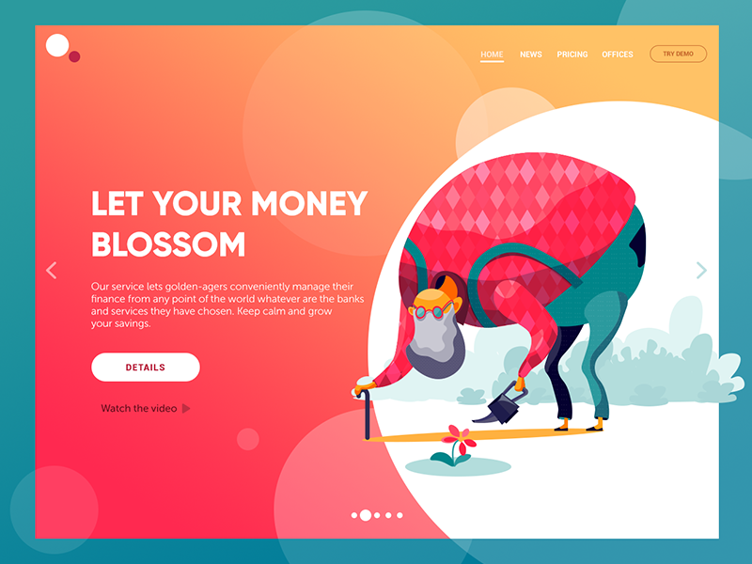
Key ways to use Graphics and Illustrations in UI design
Onboarding and Tutorials
Simple illustrations can guide new users through the app's features and functionalities, making the learning curve smoother.

Slide 67
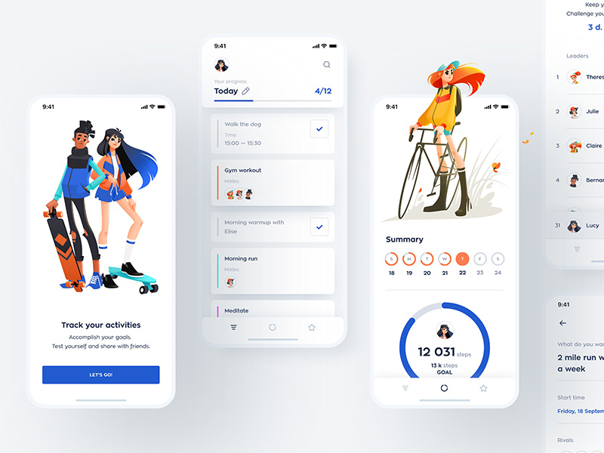
Key ways to use Graphics and Illustrations in UI design (contd.)
Explanatory Visuals
For complex concepts or data, use icons or illustrations to simplify and visually represent information, improving comprehension.

Slide 68
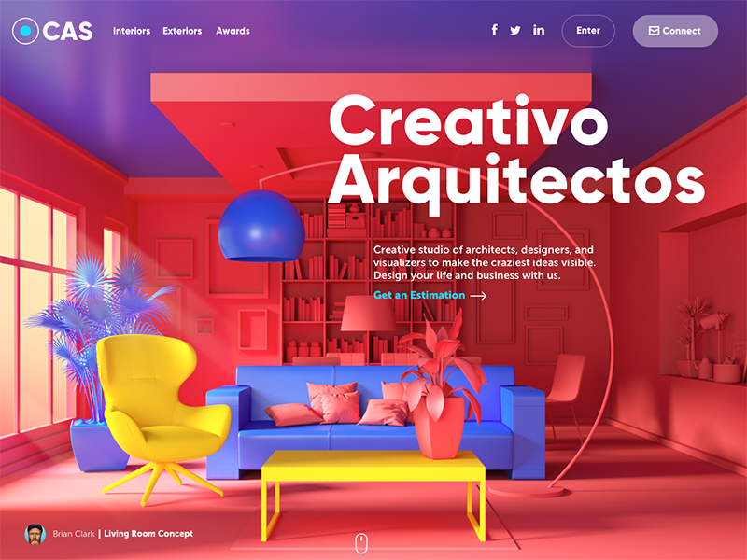
Key ways to use Graphics and Illustrations in UI design (contd.)
Hero Images
A large, visually striking illustration can be used as a focal point on landing pages or key sections to grab attention and set the tone.
Link

Slide 69
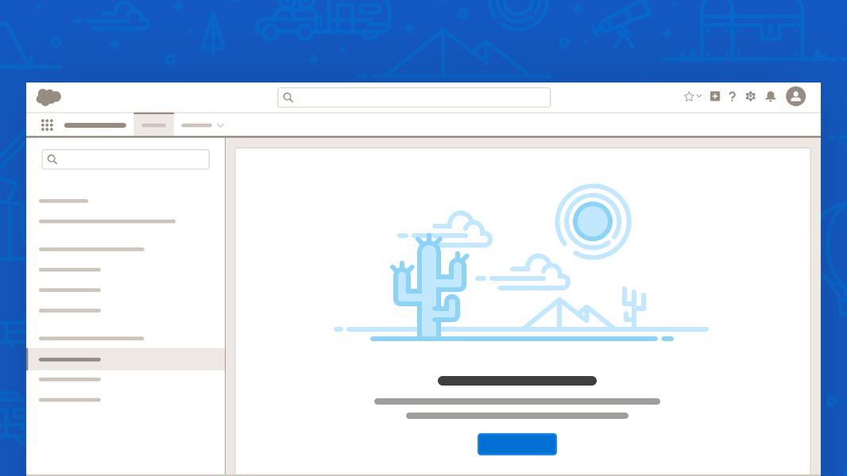
Key ways to use Graphics and Illustrations in UI design (contd.)
Empty States
When a user has no content to display, use placeholder illustrations to provide context and guide them on what to do next.
Link
Link

Slide 70
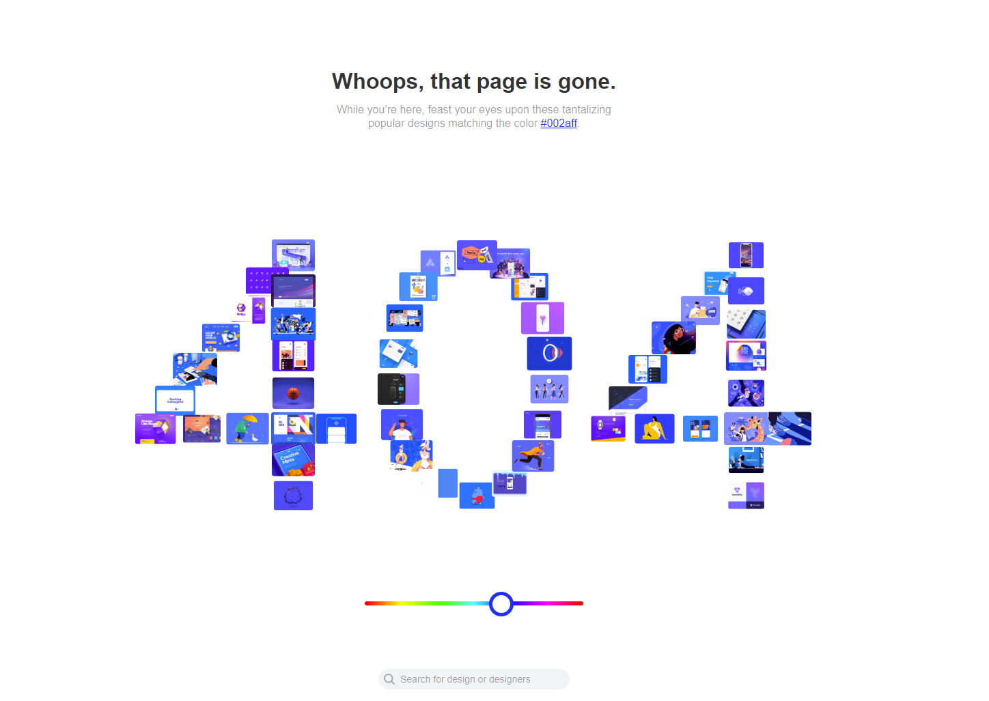
Key ways to use Graphics and Illustrations in UI design (contd.)
Error Messages
Pair error messages with friendly illustrations to soften the impact and provide visual cues about the issue.
Link

Slide 71

Key ways to use Graphics and Illustrations in UI design (contd.)
Interactive Elements
Incorporate small animated illustrations within buttons or interactive elements to add a playful touch and enhance user engagement.

Slide 72

Key ways to use Graphics and Illustrations in UI design (contd.)
Branding Consistency
Use consistent style and character design across illustrations to reinforce brand identity and recognition.
Link

Slide 73
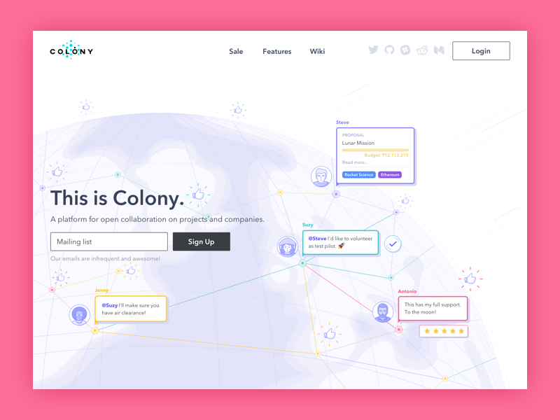
Key ways to use Graphics and Illustrations in UI design (contd.)
Visual Hierarchy
Utilize graphic elements to guide the user's eye through the interface, highlighting important information or navigation paths.
Link

Slide 74

Key ways to use Graphics and Illustrations in UI design (contd.)
Storytelling
Create a narrative through illustrations, particularly in marketing materials or app introductions, to connect with users on a deeper level.

Slide 75
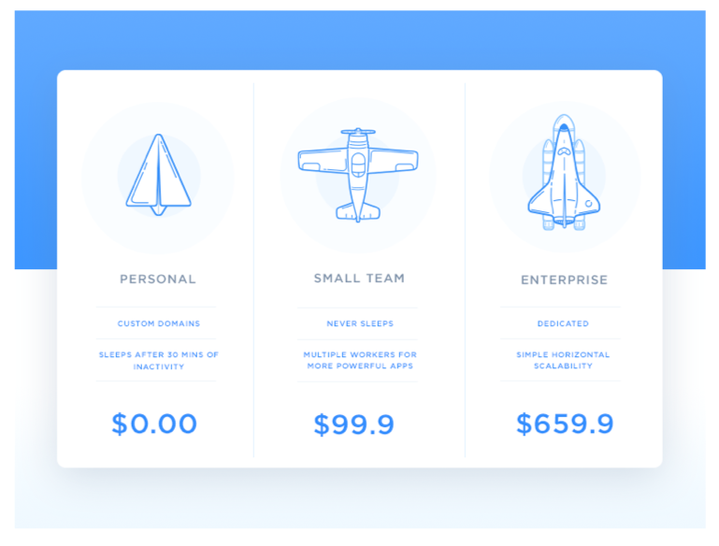
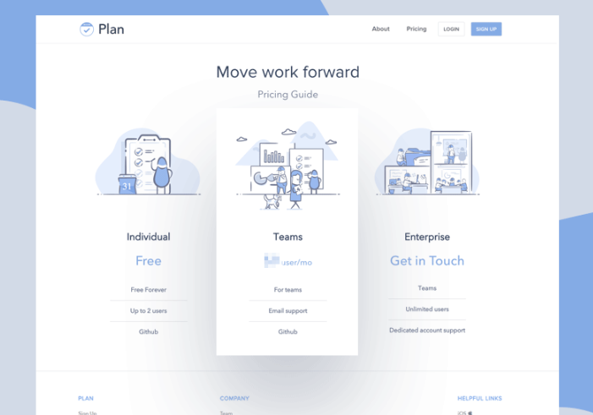
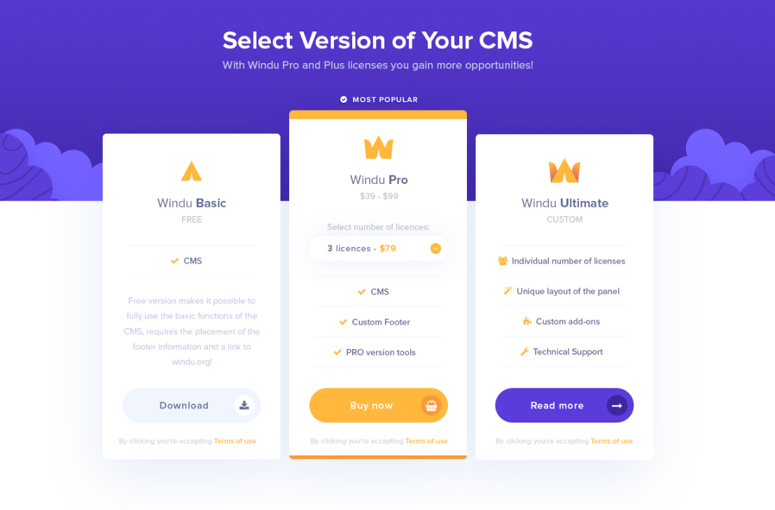
Using Containers to Finalize UI Design
Using a container in UI design is an effective way to structure and finalize your layout.
Containers help organize content, establish boundaries, and create a clean, cohesive interface.
Few tricks to grouping your content into containers
Lighten outline and use shadows
Lift off
Scale it

Slide 76
Use of Writing in UI Design
Section 5

Slide 77
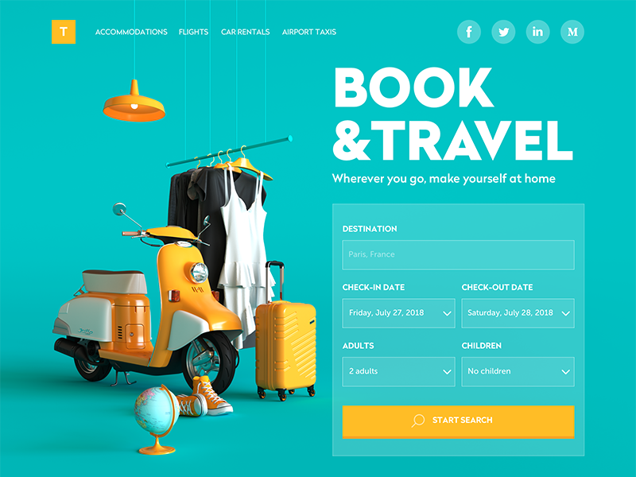
Use of Writing in UI Design
UX writing is a professional activity of writing texts for user interfaces both web and mobile.
It includes creating texts from small labels of buttons and icons to taglines, error messages, notifications, navigation prompts and instructions, guidelines, and so on.
UX writers’ task is creating texts that support and enhance users’ communication with interfaces.

Slide 78
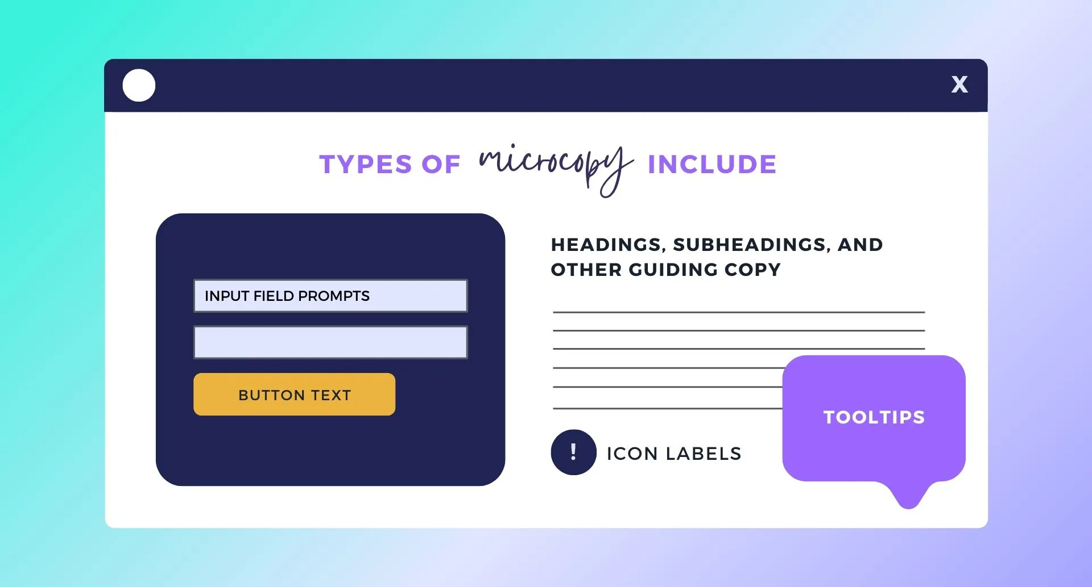
Microcopy – Use of Writing in UI Design (contd.)
Microcopy is a term used for the small pieces of content that appears on digital interfaces, from calls to action to disclaimers.
These sentences or phrases are normally quite short
Purpose: Tell users what to do next
It assures users that their personal information won't be shared.
These tiny pieces of text play a vital role in UX—and can make or break your user experience.
Good microcopy is clear, concise, and helpful; Bad microcopy can be confusing, misleading, or just plain annoying.

Slide 79
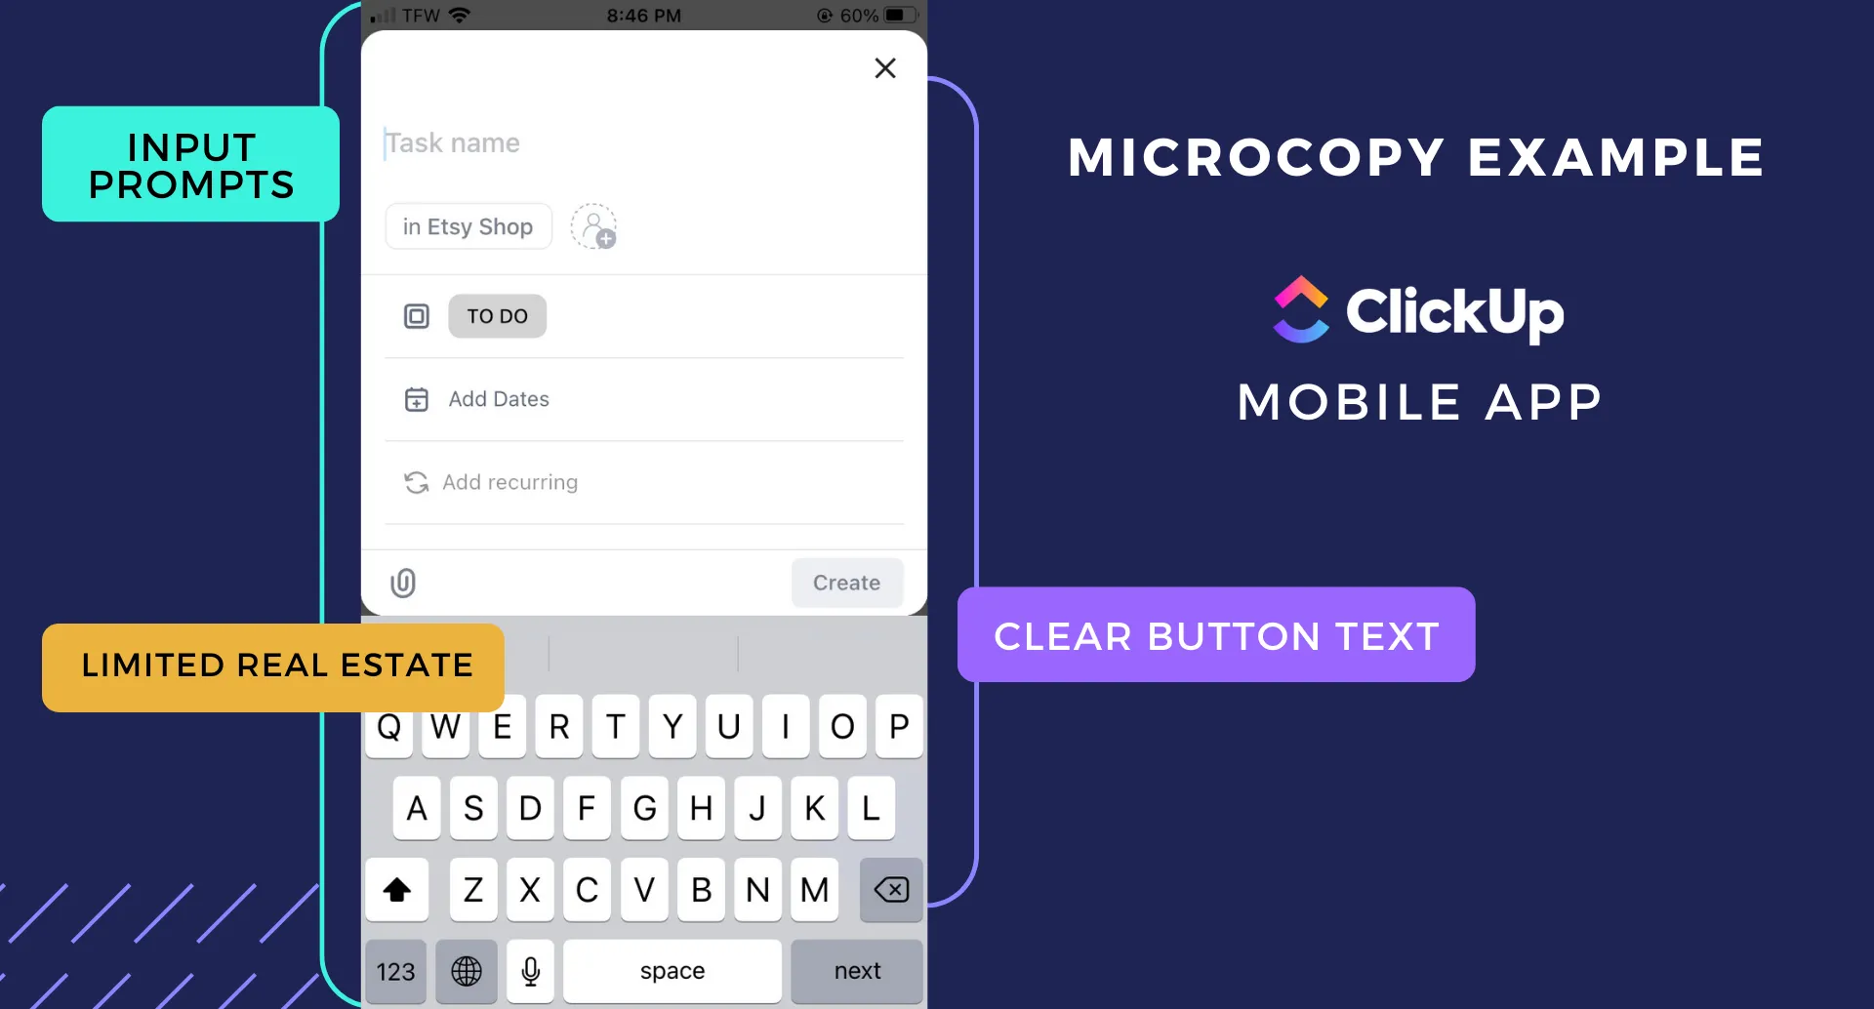
Microcopy – Use of Writing in UI Design (contd.)
Examples of microcopy in UX design include:
Text on buttons
An error message
Tooltips
Search prompts
Help text
Push notifications
The field labels on a contact form

Slide 80
User Interface Elements
Section - 6

Slide 81
User Interface (UI) Elements
UI elements are the most integral part of product design.
UI elements are the building blocks of apps and web sites.
E.g., we click on a button to sign up, use navigational components to switch between pages, etc.
We can group UI elements into 3 major categories:
Input elements – users interact with them to put in their information or move to the next step.
Output elements – those elements show the result of a previous user action.
Helper elements – further divided into navigational, informational, and containers, they help to move through the digital product, get information, and point user’s attention to some element.

Slide 82
User Interface (UI) Elements – Input Elements
Dropdowns
Combo boxes
Buttons
Toggle switches
Text fields
Date pickers
Checkboxes
Radio buttons
Confirmation dialogues

Slide 83
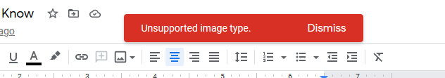
User Interface (UI) Elements – Output Elements
Show alerts
Warnings
Success
Error messages

Slide 84
User Interface (UI) Elements – Helper Elements
Notifications
Breadcrumps
Icons
Sliders
Progress bar
Tooltips
Link

Slide 85
Accessibility in Design
Section - 7

Slide 86
Accessibility in Design
Accessibility and inclusivity are branches of usability.
Accessibility and inclusivity in design is about making products and services that work for everyone, regardless of their background or circumstance.
When you design with accessibility in mind from the start, you create an environment where everyone can benefit from the product or service, not just those who don’t have any disabilities.
Accessible design helps users with different levels of ability.
Many users struggle to interact with digital products because of visual, auditory, cognitive, emotional, or motor challenges.
Inclusive design welcomes users from diverse backgrounds, ensuring that factors such as race, gender, and religion do not hinder their digital experiences.
Link

Slide 87
Inclusive Design
Inclusive design describes methodologies to create products that understand and enable people of all backgrounds and abilities.
Inclusive design may address accessibility, age, culture, economic situation, education, gender, geographic location, language, and race.
The focus is on fulfilling as many user needs as possible, not just as many users as possible.
It is about empathizing with users and adapting interfaces to address the various needs of those users.
Two concepts related to inclusive design are accessibility and universal design.

Slide 88




Inclusive Design Patterns - Example
The Problem
Bad eyesight / Elderly person / Trouble with light mode
The Solution
"The internet is unfriendly to people with bad eyesight."
To make your UIs more inclusive, opt for legible fonts and offer a button for users to increase the font size.
Consider adding dark-mode option for your user who have trouble processing interface in light mode.

Slide 89
Inclusive Design Patterns - Example
The Problem
Not able to put in original name/surname in the field provided due to special character. E.g. Martínez del Río
The Solution
Facebook has provided a support page for user who were not able to login due to special character in their name
The form requested users to attach a document that confirms their name.

Slide 90
Inclusive Design Patterns - Example
The Problem
Not able to find demographic identifiers (e.g., race, gender)
The Solution
Tinder allowed users to type a word that described their gender identity and provided more than 30 options.

Slide 91
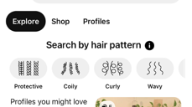
Inclusive Design Patterns - Example
Adding Delights
Understand the needs of your users, come up with some delightful ways to satisfy those needs.
The Solution
Pinterest, an image-sharing app, released a new feature which allowed users to filter based on some nontraditional options — for example, by hair pattern (e.g., protective, curly, straight)
Sephora allowed users to search skincare products by Age Range (e.g., Teens, 20s, 30s)

Slide 92
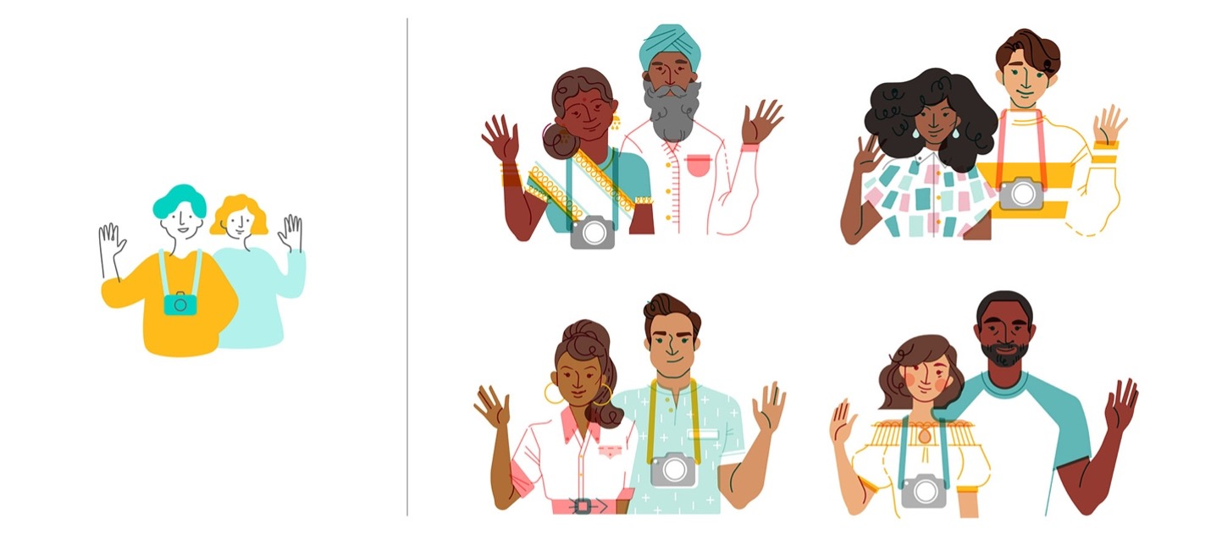

Inclusive Design Patterns - Example
The Problem
Diverse Illustrations
The Solution
Companies have shifted their illustrations and imagery to be more diverse and align with their user populations.

Slide 93
Thank you

